Slide 1
Absolute Motion Analysis
Dr. Jacob Moore
Associate Professor of Engineering
Penn State Mont Alto

Slide 2
Planar Motion Analysis
When analyzing rigid body motion beyond fixed axis rotation. There are two general strategies, absolute motion analysis, and relative motion analysis.
In absolute motion analysis, a set of constraint equations is used to determine the position of a set point over time with respect to the ground, the velocity and acceleration of that point will be equal to the derivatives of the original equation.
In relative motion analysis, a series of equations describe the positions, velocities, and accelerations of several intermediate points leading from the ground to the point of interest. General polar motion equations are used to describe velocities and accelerations for each step, and the steps are all added together in the end.

Slide 3
Absolute vs. Relative Analysis
Absolute Motion Analysis:
Involves calculus
Does not involve coordinate transformations
Faster and easier for simple problems
Relative Motion Analysis:
Does not involve calculus
Involves coordinate transformations
Faster and easier for complex problems

Slide 4
Absolute Motion Analysis
Absolute motion analysis is based in geometry and then calculus, relating the position of a point to an origin point using geometric relationships.
This is similar to what we did with dependent motion analysis.
The first step in absolute motion analysis is to write out the equations for the x and y position of a point you are examining with respect to some other stationary point.
Any variables that will change over time must be left as variables.
Any variables that remain constant can be written in as numbers.

Slide 5
Absolute Motion Analysis
To determine the location of point C, we would need the two lengths and the two angles.
What will change over time?
What will not change over time
L2
C
y
$$ϕ$$
L1
B
$$θ$$
x
A

Slide 6
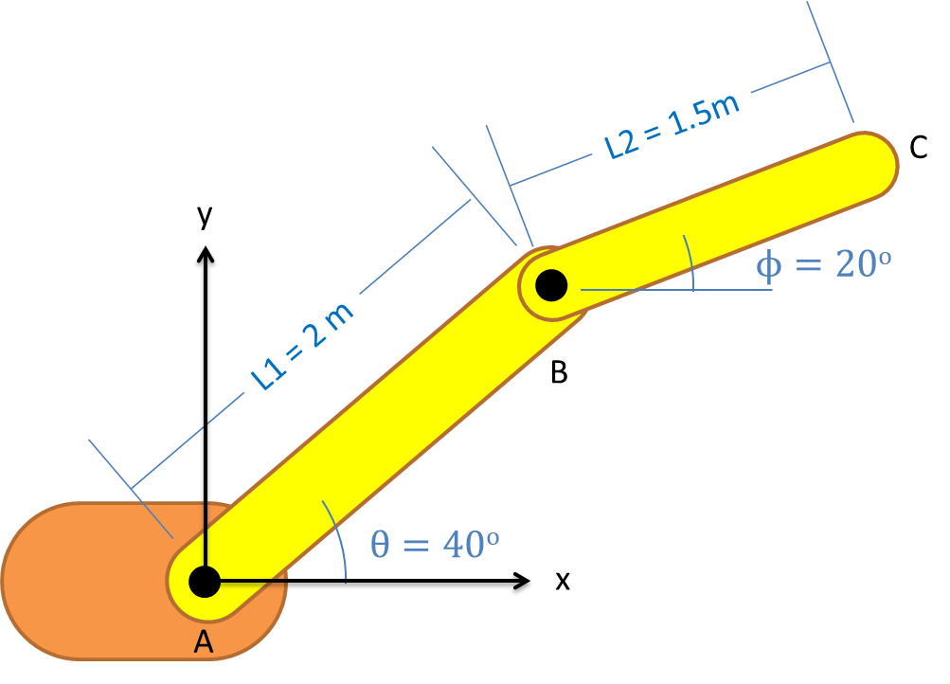
Absolute Motion Analysis
$$x_{c}=2\cos\left(θ\right)+1.5cos⁡(φ)$$
$$y_{c}=2\sin\left(θ\right)+1.5sin⁡(φ)$$

Slide 7
Absolute Motion Analysis
Once you have the equations for the position of the point of interest, take the derivative of those functions with respect to time to find the velocity of that point over time.
Once you have the equations for the velocity of the point of interest, take the derivative again to find the acceleration functions.

Slide 8
Absolute Motion Analysis Process
Start by creating a diagram of the body, with the key distances and angles labeled
Be sure to identify what distances and/or angles are constant and which will change over time
Next, pick a point for analysis and write out an equation for the x and y position of that point with relation to some fixed origin.
Any constant distances or angles can be put into the equation as numbers
Anything that changes must be left as a variable
Take the derivative of these position equations to find the equations for the x and y velocities of your chosen point
Take the derivative of the velocity equations to find the equations for the x and y acceleration of your chosen point.
Use the equations you have generated, along with any current angles, distances, velocities, and accelerations to solve for the unknowns

Slide 9
Thanks for Watching
See other engineering mechanics videos and access the full tool at…

Slide 10
Worked Example
The robotic arm shown below has a fixed orange base at A and fixed length members AB and BC. Motors at A and B allow for rotational motion at the joints. Based on the angular velocities and accelerations shown at each joint, determine the velocity and the acceleration of the end effector at C.
y
A
3 ft
B
x
30º
5 rad/s
3 rad/s
-2 rad/s²
.2 rad/s²
2 ft
C

Slide 11


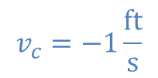
Worked Example
The robotic arm from the previous problem is in the configuration shown below. Assume that theta is currently 30 degrees and that point C currently lies along the x axis. If we want the end effector at C to travel 1 ft/s in the negative x direction, what should the angular velocities be at joints A and B?
y
B
3 ft
2 ft
$$ϕ$$
$$θ$$
x
$$v_{c}=−1\frac{ft}{s}$$
A
C

Slide 12
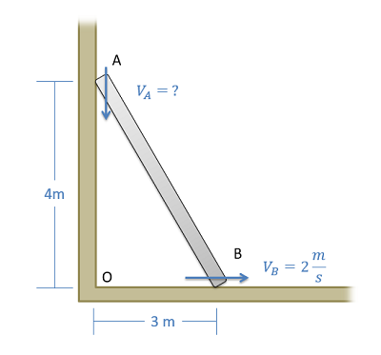
Worked Example
A ladder is propped up against a wall as shown below. If the base of the ladder is sliding out at a speed of 2 m/s, what is the speed of the top of the ladder?

Slide 13
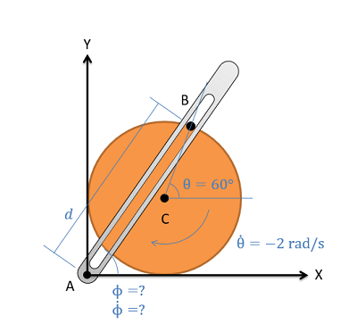
Worked Example
The crank-rocker mechanism as shown below consists of a crank with a radius of .5 meters rotating about its fixed center at C at a constant rate of 2 rad/s clockwise. Rocker AB fixed at it's base at A and connects to point B along the edge of the crank. The pin at point B can slide along a frictionless slot in AB. In the current state, what is the angular velocity of rocker AB?

Slide 14
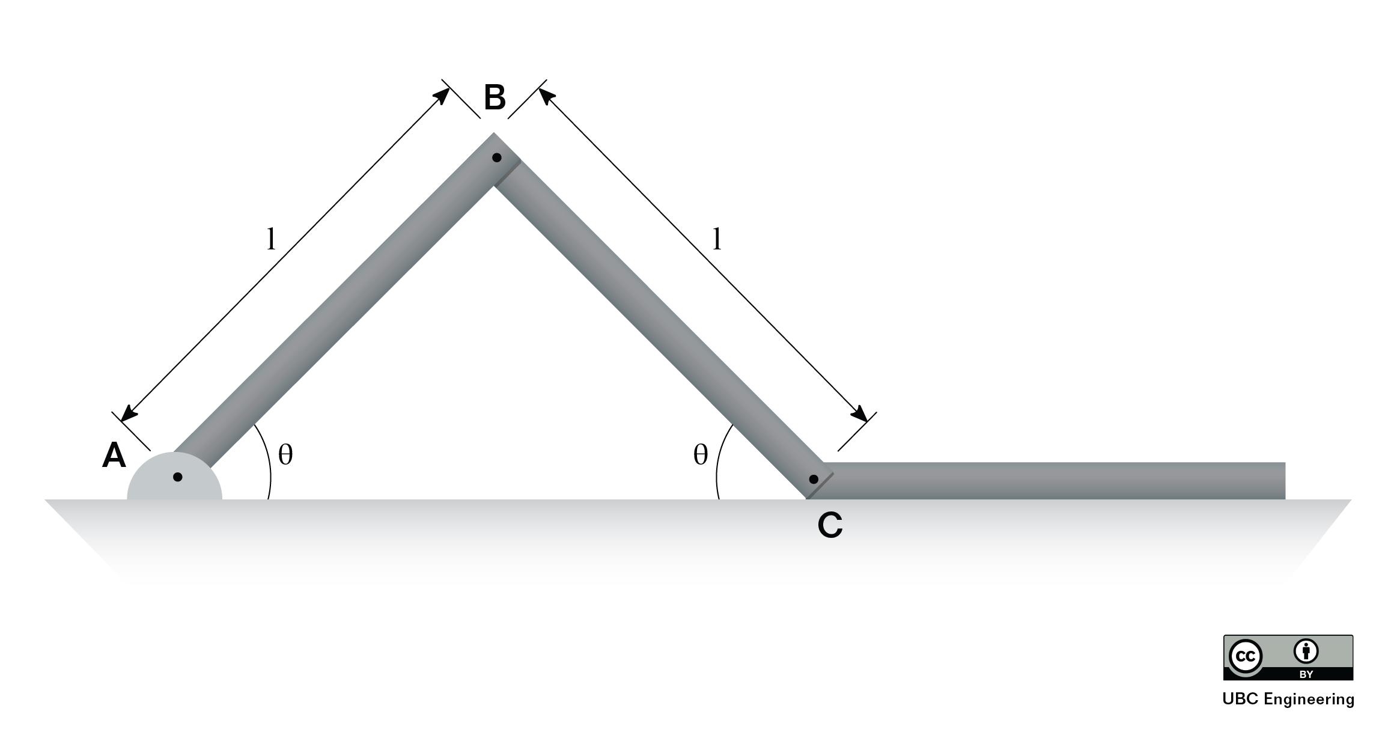
Worked Example
Determine the angular velocities and angular accelerations of links AB and BC if end D has a velocity of v=3m/s to the right and an acceleration of a=1m/s² to the left. Link AB and BC both have a length l=0.5m and the angle is given as θ=60deg.

Slide 15
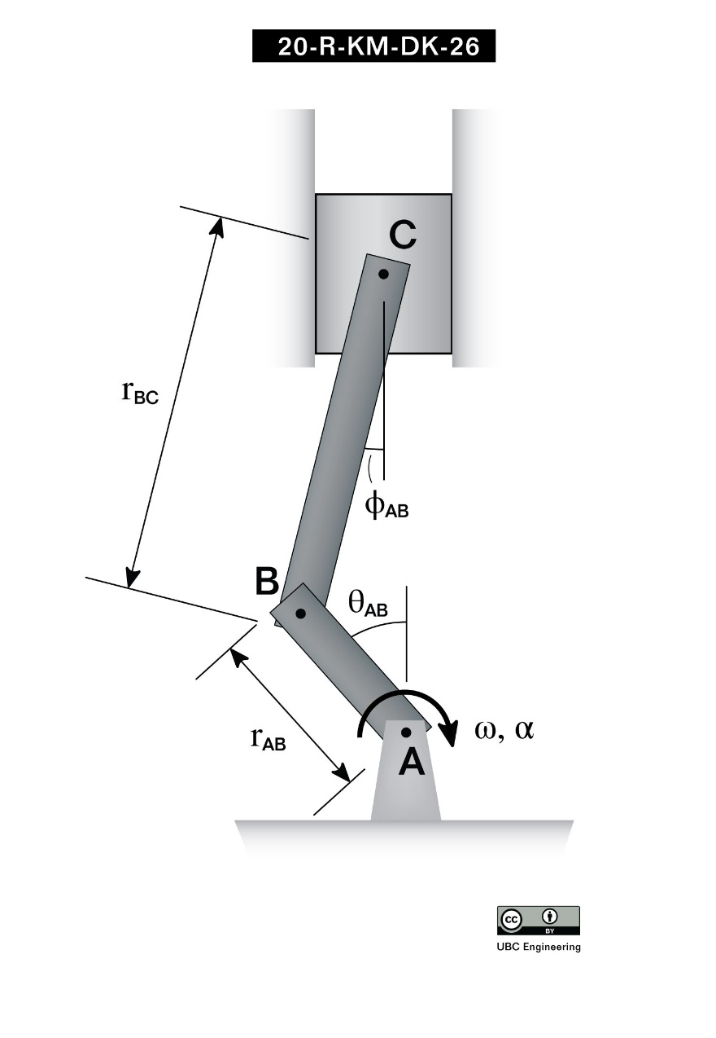
Worked Example
Students are attempting to create a lift to raise their model car. The lift is assembled with two linkages, link AB and link BC, as seen in the picture shown. If the links have length l_{AB}=0.2 m and l_{BC}=0.4 m, determine the velocity and acceleration of the lift at the instant where the angular velocity of AB is ω_{AB}=-5 rad/s and the angular acceleration of AB is α_{AB}=-7 rad/s². Take the angles to be θ=30 deg and ϕ=20 deg.

